Slide 1
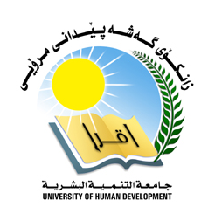
Introduction to computing
OPERATING SYSTEM

Slide 2
Lecturer Details
What is operating system?
Operations of OS
Structure of OS
Features of OS
GUI
Multiuser
Multitasking
Multiprocessing
Multithreading
Types of OS
Advantages and Disadvantages

Slide 3
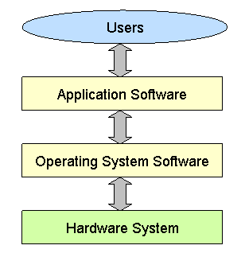
What is operating system?
An operating system (OS) is a collection of software that manages computer hardware resources .
Without a computer operating system, a computer would be useless
“The operating system acts as a Interface Between the user and computer hardware”

Slide 4
Operation of OS
Start and shut down a computer
Provide a user Interface
Configure Devices
Operation of OS
Manage Programs
Establish An Internet Connection
Manage Memory
Control a network

Slide 5
Structure of OS
User Interface
User interact with operating system
Kernel
Core of operating system, responsible for loading operating system

Slide 6
Features of OS
Operating System
Multiuser
Multitasking
GUI
Multiprocessing
Multithreading

Slide 7
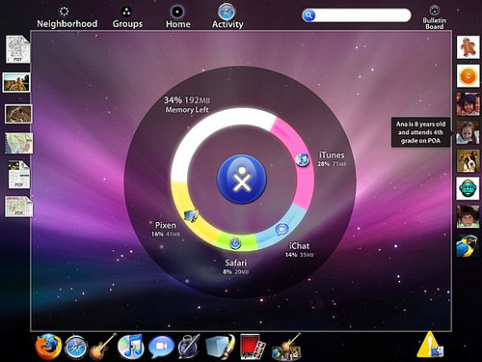
GUI
GUI - Short for Graphical User Interface, a GUI Operating System contains graphics and icons and is commonly navigated by using a computer mouse.

Slide 8
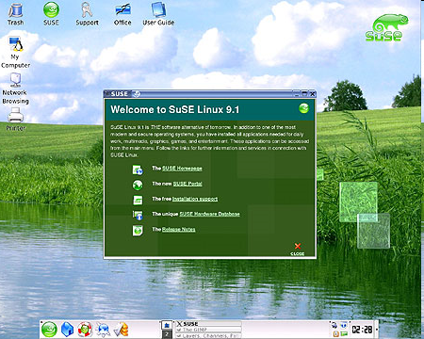
Multi-user
Multi-user - A multi-user operating system allows for multiple users to use the same computer at the same time and/or different times.
example (LINUX)

Slide 9
Multi Tasking
An operating system that is capable of allowing multiple software processes to run at the same time.
Below are some examples of multitasking operating systems.
Unix
Windows XP,Vista,7,8

Slide 10
Multi Processing
An operating system capable of supporting and utilizing more than one computer processor.
More than one CPUs that can be shared
Below are some examples of multiprocessing operating systems.
Linux
Unix
Windows 8

Slide 11
Multi Threading
Smaller parts of a program are loaded when needed by OS
Operating systems that allow different parts of a software program to run concurrently
Operating systems that would fall into this category are:
Linux
Unix
Windows

Slide 12
Types of operating system
Stand Alone operating system.
Server operating system.
Embedded operating system.

Slide 13
Operating system
Stand Alone operating system/Desktop operating system
Stand Alone operating system
WINDOWS
MAC OS
LINUX

Slide 14
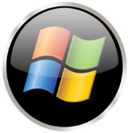
Windows
Advantages & Disadvantages of Windows
Disadvantages
Expensive
Not Stable
Not secure
Advantages
Familiar
Gaming
Update
Easy to use

Slide 15
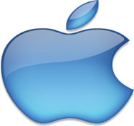
Mac
Advantages & Disadvantages Of MAC OS
Advantages
Great GUI
Better to graphic designer
Stable
Secure
Disadvantages
Not gaming
More Expensive
Than window
Not all software run

Slide 16

Linux
Advantages & Disadvantages of LINUX
Disadvantages
Not all software run
Hard to learn , use and install
Not familiarity
Advantages
Free
Secure
Low pc requirement

Slide 17
Server Operating system
1.Server operating systems are designed to provide platforms for multi-users , for critical, network applications.
2.Their main purpose is to provide security, stability and collaboration.
3.Most of them come with a pack of dedicated software tools such as Web servers, e-mail agents and terminal services
The common applications for server OSes are:
File and printer sharing
Application services (including databases)
Web site services
E-mail, groupware and messaging
Terminal services
Caching

Slide 18
Server Operating system
Server Needs
SERVER NEEDS
Administration
Stability
Security

Slide 19








Mobile Operating system
Mobile OS
Symbian OS
iPhone OS
RIM BlackBerry
Windows Mobile
Linux
Palm OS

Slide 20
BEST OPERATING SYSTEMS OF 2013
UBUNTO 12.10
WINDOWS 8
MACINTOSH
WINDOWS 8
LINUX MINT

Slide 21
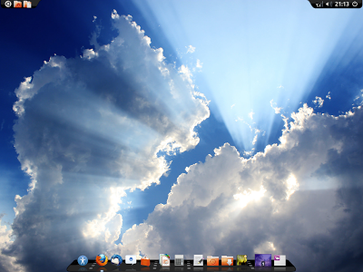
UBUNTO 12.10
PROS:
Elegant Graphics
Virus free
Faster Access
Better Stability
Free ubunto cloud storage.
CONS:
It doesn't include audio,video codecs.

Slide 22
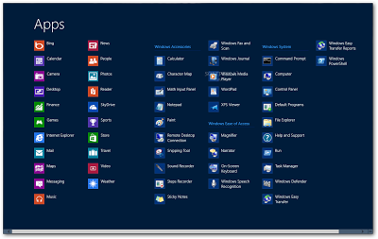
WINDOWS 8
PROS:
Better Stability
Can be used as a primary OS.
Awesome supports with tablets.
CONS:
Virus Prone.
Paid
Start menu disappeared.

Slide 23
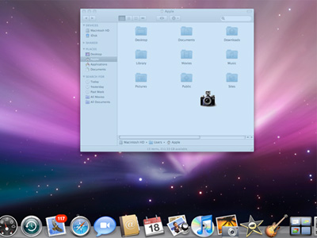
MACINTOSH
PROS:
Fabulous Graphics.
Better Stability.
Great Effects.
Awesome Interface.
CONS:
Virus Prone.
Size is almost 3 GB.

Slide 24
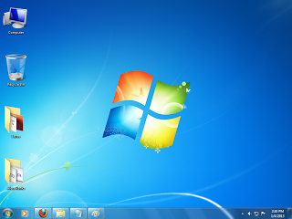
WINDOWS 7
PROS:
Nice Animation.
Better Stability.
Less Vulnerable.
Great Aero Effects.
CONS:
Crashes Several Times.
Virus Prone.
Large size almost 3-4 GB.

Slide 25
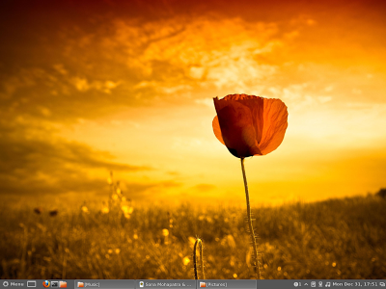
LINUX MINT
PROS:
Virus Free
Faster
Audio and Video pre included.
CONS:
Low Graphical User Interface

Slide 26
Operating System
In pair discuss the following questions:
How many operating system can you think of? Make a list.
What are the operation of operation system?
What does GUI stand for?

Slide 27
Operating System
Operation collaboration elegant appear(disappear)
fabulous
Crash
stable
secure
expensive
grate
standalone
Establish
connection configure
kernel
Responsible
load
multi
multiple
task
process
thread
thread
Graphic
common
navigate
same
Collection
Without Use(useless)
Act
Interface
Utilize
Support Concurrently
Fall
Category
Familiar

